Slide 1

INTRODUCTION TO EXPLORATORY DATA ANALYSIS (EDA)
EASY
ADVANCED

Slide 2
EXPLORATORY DATA ANALYSIS (EDA)
Exploratory Data Analysis (EDA) is a process used by data scientists to analyze data and gain valuable insights.
EDA empowers data scientists to gain better understanding of the data, detect patterns, and identify outliers.
EDA tools work by generating statistical summary (Minimum, Maximum, Mean, and Count) and perform data visualizations.
EDA is the first step in developing any machine learning workflow.
Once EDA is complete, data can proceed to the next step which is data engineering.
Exploratory Data Analysis (EDA)
Data/Feature Engineering
Modeling
Deployment and Inference

Slide 3
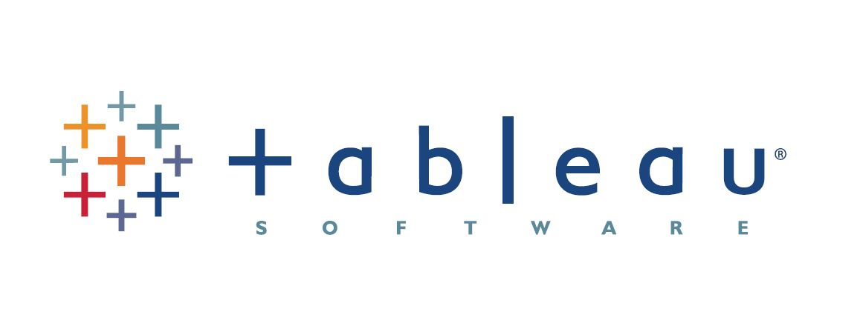


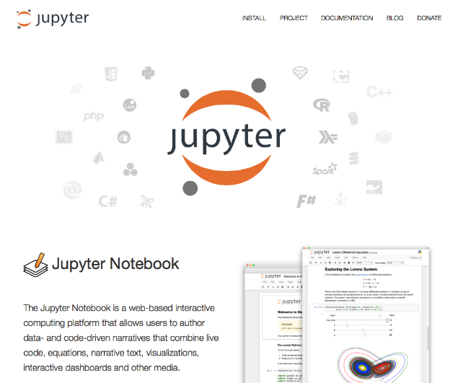

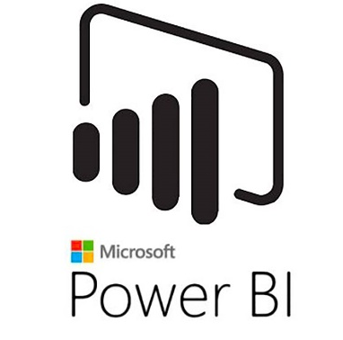
DATA VISUALIZATION
In order to perform data visualization, there are generally two approaches: (1) Use Developer tools or (2) use Business intelligence tools.
DEVELOPER TOOLS
BUSINESS INTELLIGENCE TOOLS
TABLEAU
AMAZON
QUICKSIGHT
AMAZON SAGEMAKER
POWER BI

Slide 4
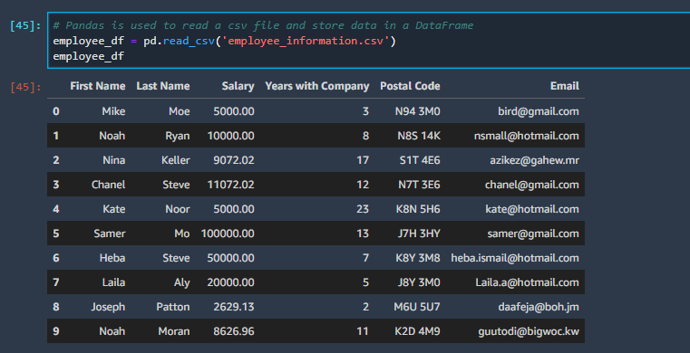
PANDAS LIBRARY 101
Pandas is an open source library that offers high-performance data structures and data analysis tools in python.
Data can also be stored using pandas DataFrame.
Think of it as using Microsoft excel in python/Jupyter environment.
THIS IS WHAT PANDAS DATAFRAME LOOK LIKE! IT’S A MULTI-DIMENSIONAL TABLE

Slide 5
PROJECT OVERVIEW
EASY
ADVANCED

Slide 6
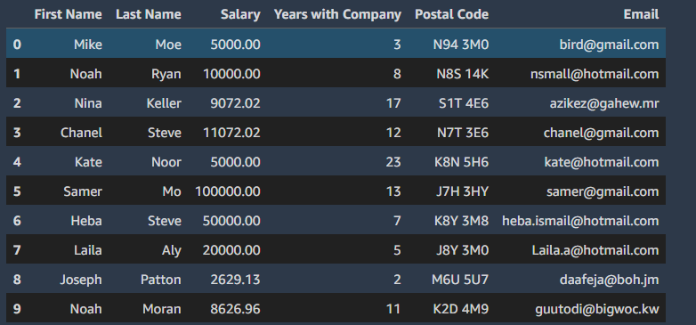
PROJECT OVERVIEW
We will analyze corporate employee information using Pandas in Jupyter Notebooks in AWS SageMaker Studio.
We will learn how to:
Define a pandas Dataframe
Read CSV Data using Pandas
Perform basic statistical analysis on the data
Set/Reset Pandas DataFrame Index
In the final project, you will perform basic EDA on a brand new dataset.

Slide 7
AMAZON SAGEMAKER STUDIO SETUP
EASY
ADVANCED

Slide 8
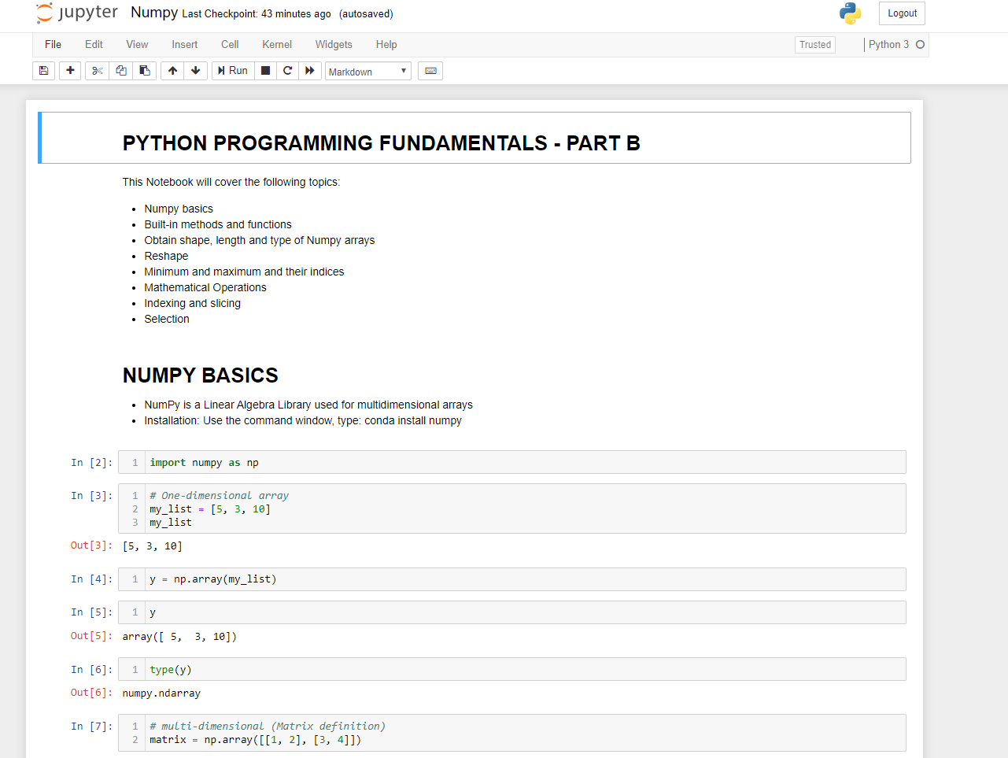
JUPYTER NOTEBOOKS
Jupyter Notebooks are open-source web application that enable developers to develop and distribute codes, text, equations, and figures in one place.
It’s one of the top tools used by machine learning developers.
In Jupyter notebooks, you can write in 40 programming languages such as Python, R, and Scala.
You can Share notebooks including code results with other.
https://jupyter.org/

Slide 9
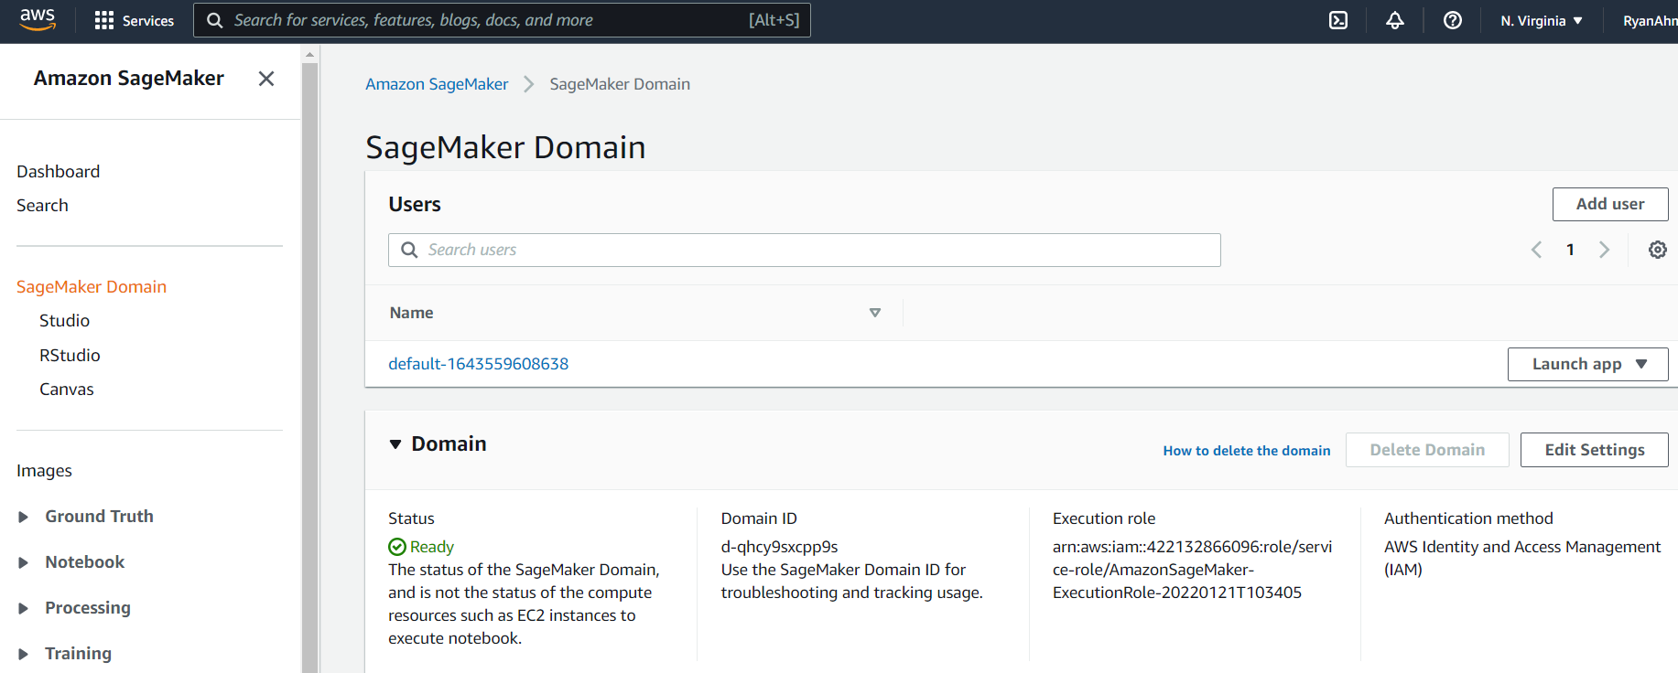
JUPYTER NOTEBOOKS IN SAGEMAKER STUDIO
LAUNCH SAGEMAKER STUDIO

Slide 10
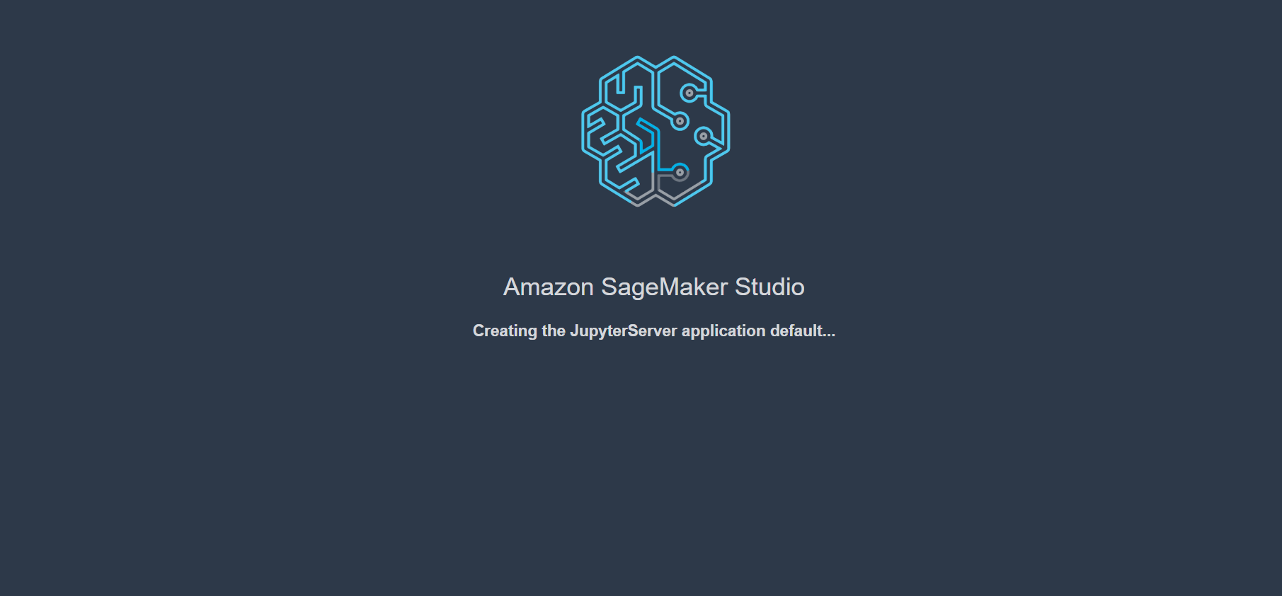
JUPYTER NOTEBOOKS IN SAGEMAKER STUDIO
YOU SHOULD SEE THIS SCREEN!

Slide 11
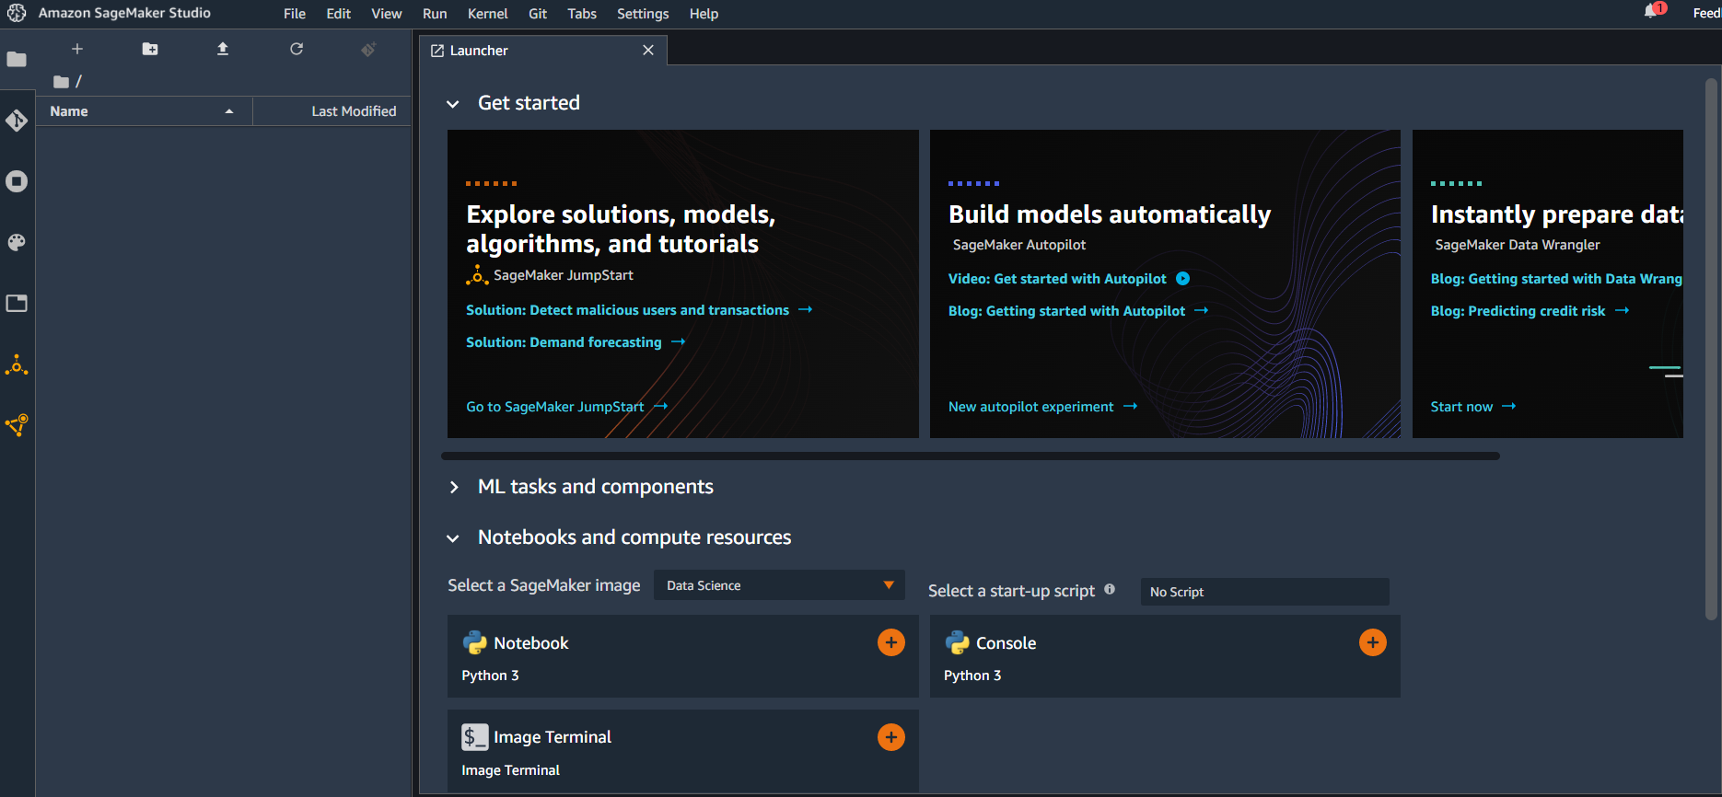
JUPYTER NOTEBOOKS IN SAGEMAKER STUDIO
WELCOME TO SAGEMAKER STUDIO HOME PAGE!

Slide 12
JUPYTER NOTEBOOKS IN SAGEMAKER STUDIO
CLICK ON NOTEBOOK (PYTHON 3) OR UPLOAD TO CREATE A BLANK NEW JUPYTER NOTEBOOK

Slide 13
JUPYTER NOTEBOOKS IN SAGEMAKER STUDIO
ALTERNATIVELY, YOU CAN CLICK ON THE UPLOAD BUTTON TO LOAD YOUR OWN NOTEBOOK

Slide 14
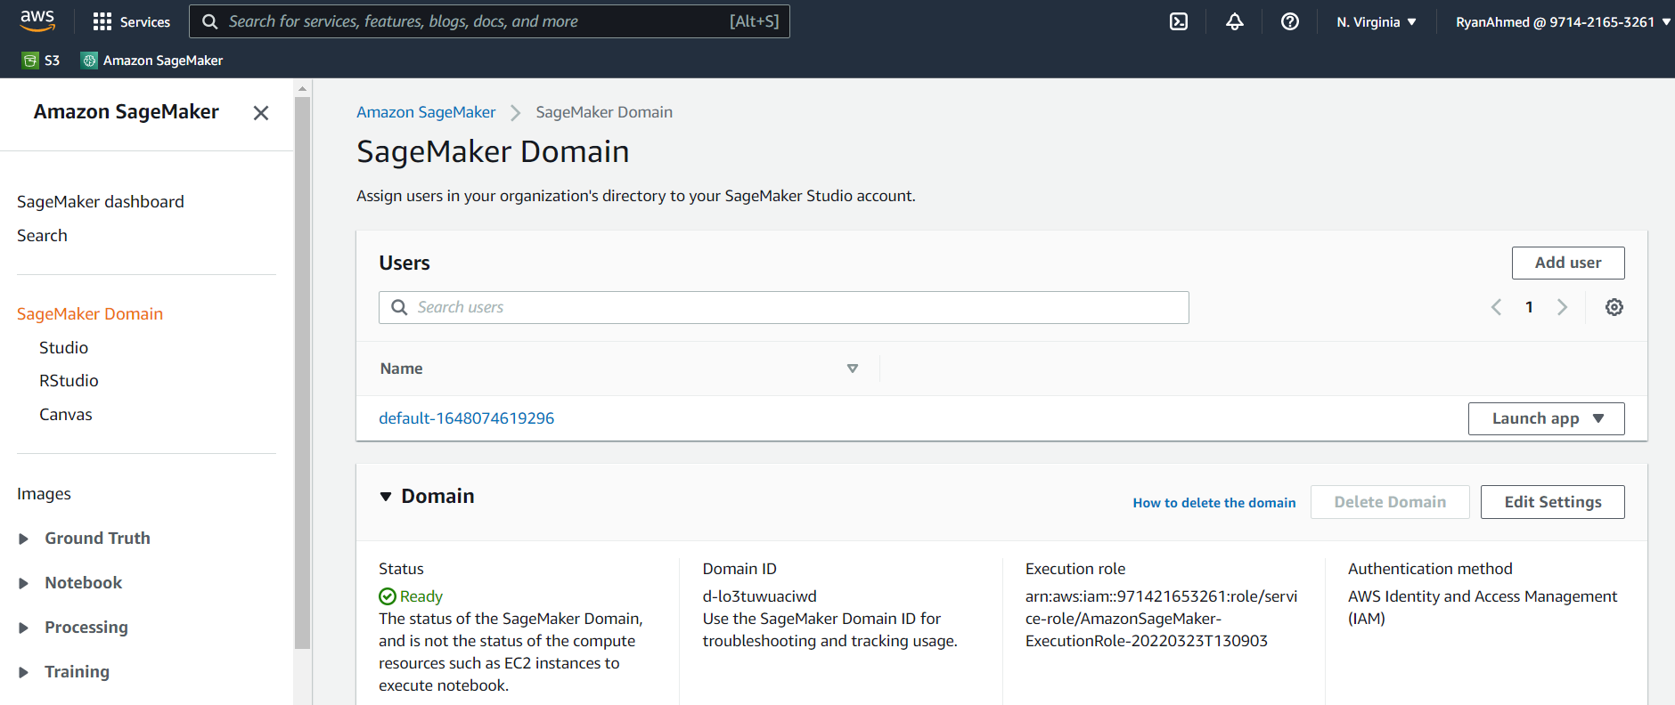
AWS SAGEMAKER SETUP
ALTERNATIVELY, WE CAN USE SAGEMAKER STUDIO. CLICK ON STUDIO AND CLICK ON LAUNCH APP>STUDIO

Slide 15
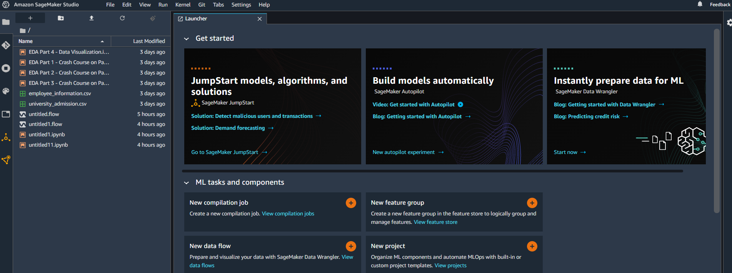
AWS SAGEMAKER SETUP
CLICK ON UPLOAD AND SELECT THE DATASET AND JUPYTER NOTEBOOK

Slide 16
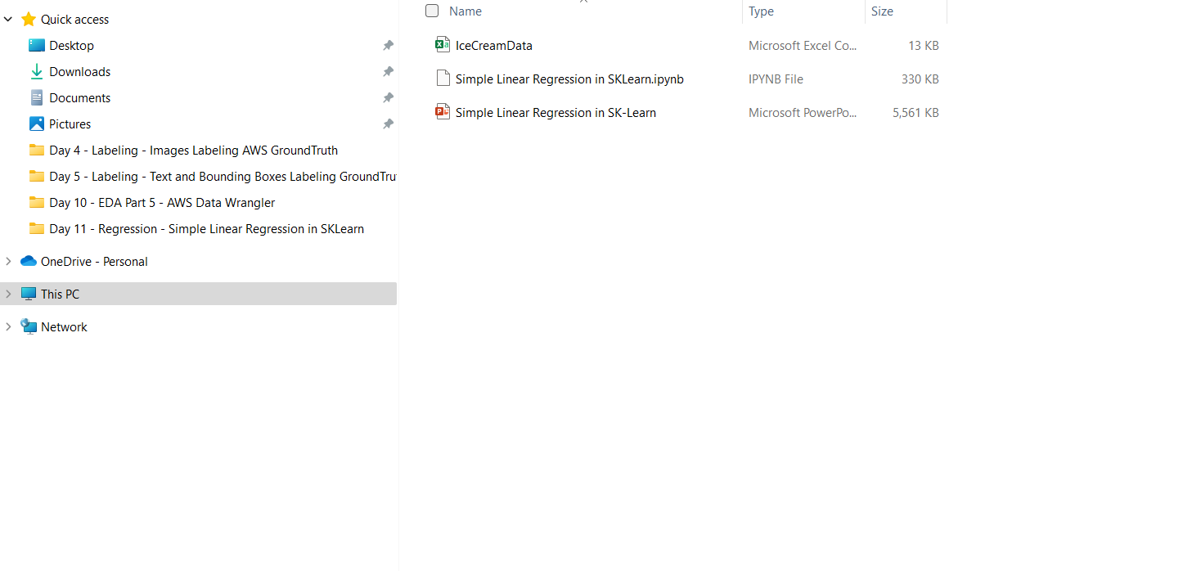
AWS SAGEMAKER SETUP
SELECT THE NOTEBOOK AND ICECREAMDATA

Slide 17
FINAL END-OF-DAY CAPSTONE PROJECT
EASY
ADVANCED

Slide 18
FINAL PROJECT
- In this project, we will perform basic Exploratory Data Analysis (EDA) on the University Admissions Dataset
- Columns definitions are as listed below:
GRE Scores (out of 340)
TOEFL Scores (out of 120)
University Rating (out of 5)
Statement of Purpose (SOP)
Letter of Recommendation (LOR) Strength (out of 5)
Undergraduate GPA (out of 10)
Research Experience (either 0 or 1)
Chance of admission (ranging from 0 to 1)
- Using the "university_admision.csv" included in the course package, write a python script to perform the following tasks:
1. Import the "university_admission.csv" file using Pandas
2. Display the first and last 8 rows in the DataFrame
3. Obtain the shape of the DataFrame
4. Calculate the average, min and max values for the LOR and SOP Columns
5. Use the GRE Score as the pandas dataframe index

